Slide 1

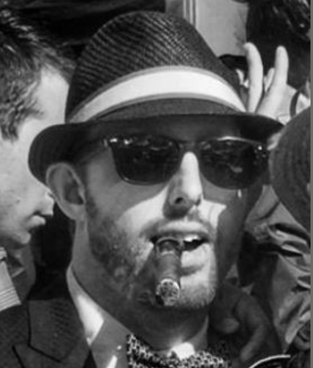

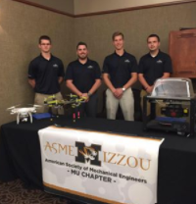
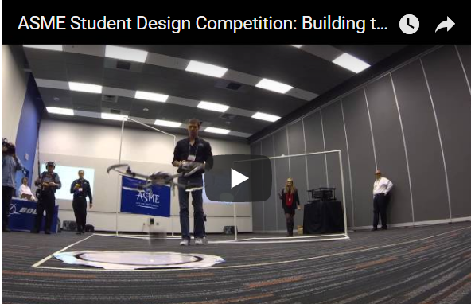


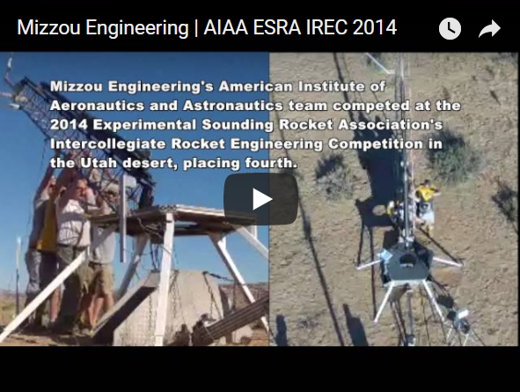
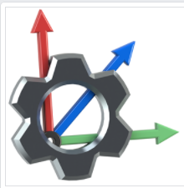
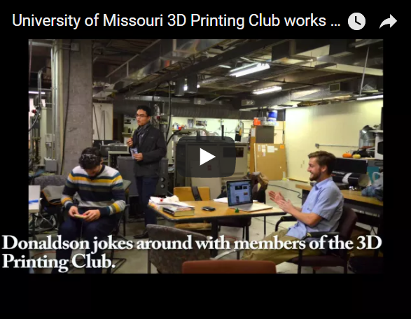
Brandon Torres
Student
CLUBS
1550 pts
Photos
Videos
Message
Email
Follow
University of Missouri Columbia
Bachelors in Mechanical Engineering
Expected Graduation: May 2017
ABOUT:
I am currently a student at the University of Missouri Columbia majoring in Mechanical & Aerospace Engineering. To date I have gained hands on experience in many areas of aerospace engineering including competing in an Intercollegiate Rocket Engineering Competition for AIAA (American Institute of Aeronautics and Astronautics) MU and an Unmanned Aerial Vehicle Competition for ASME (American Society of Mechanical Engineers). As of now I hold an officer position in 4 academic clubs and 1 national Vice Chair of Communications of the Student District Operating board of District 2 for ASME. At the University of Missouri I am trying not only to obtain great education but to make a difference for the future of the Engineering program. One way I have reached that goal was recently I co-founded the first MU chapter academic club SEDS. \(Students for the Exploration and Development of Space\). The club is designed to promote space exploration and develop a better understanding of space. Other than engineering competitions I try to reach out to the younger generation students in our local community to help promote the importance of studying STEM base subjects. Hosting rocket camps, traveling to schools to teach, and giving tours are just a small amount of the involvement that I've done throughout my career.
Vice President:
American Society of Mechanical Engineering
What I do for ASME…
10 pts
Treasurer: American Institute of Aeronautics and Astronautics
What I do for AIAA…
150 pts
Member:
3D Printing Club
What I do for 3D Printing…
160 pts
RESUME

Slide 2
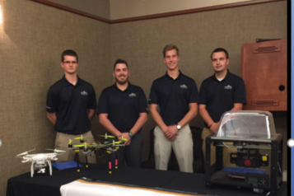
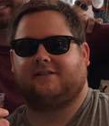

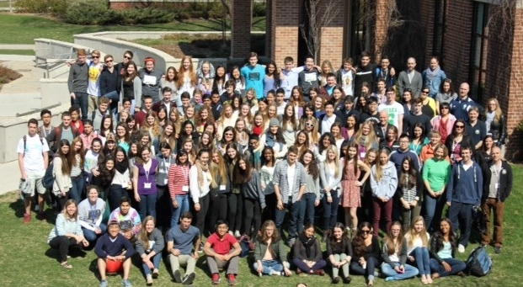


American Society of Mechanical
Engineers-student chapter
ASME
members
CLUBS
Meeting tIMES
BUILD TEAM MEETINGS:
Date MWF
Time 4:00pm
NEXT MONTHLY MEETING:
Date 6/2/2017
Time 6:00pm
1550 pts
President:
Brandon Torres
Photos
Videos
Message
Email
Call
152520252 pts
University of Missouri Columbia
150 pts
MISSION
To give students the knowledge, team work skills, and experience to gain employment and become leaders in the engineering field
Vice President:
Mike Jones
FACTS
Competitions, YEAR:
ASME ROBOTICS 2017
ASME ROBOTICS 2016
ESRA 3D MECHANICS 2015
AWARDS:
1st Place: ASME ROBOTICS 2017
Charles T. Main Award 2017
3rd Place: ASME ROBOTICS 2016
Welcomed Majors:
All Majors
Major Percentage: Mech Engineering : 98%
Civil Engineering: 1%
Undeclared: 1%
Message Board: We will be having a ASME Rocket Camp for middle school students from the age 8-15 on Aug 15th, 2017! We need Volunteers! If you would like to Volunteer, please contact us!! Thanks!
50 pts
Majors Seeking:
Mechanical Engineers
Electrical Engineers
UCTechWeb Active Member:
Renee Smith
Spring Year: 2017
We have a robotics team that travels around the world and competes against all different universities. The team is lead by Brandon Torres, a senior mechanical Engineer with the advisory help of Dr. Solbreken. Together the team has overcame real world challenges in a smaller scale through competition. If you are into robotics, challenges, and competition please follow us on CSC and come to our meetings!!!
more
1550 pts
50 pts
Team:
All Members
Spring Year: 2016
We have a robotics team that travels around the world and competes against all different universities. The team is lead by Brandon Torres, a senior mechanical Engineer with the advisory help of Dr. Solbreken. Together the team has overcame real world challenges in a smaller scale through competition. If you are into robotics, challenges, and competition please follow us on CSC and come to our meetings!!!
more
1600 pts
HOW TO HELP

Slide 3

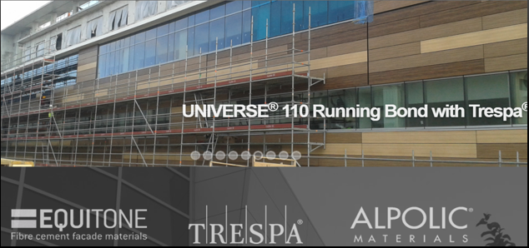

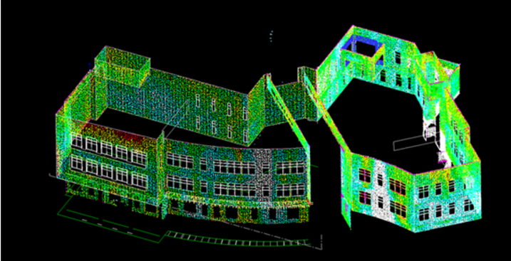
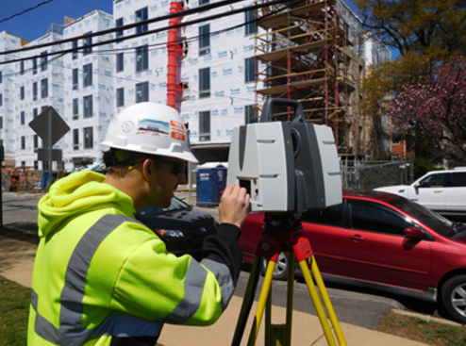
Universe Corporation
Job Openings
COMPANY
Location
Mechanical Engineering:
3D Printing Specialist
Laser Scan Technician
Saint Louis, MO
Electrical Engineering:
Drafting Position
Laser Scan Technician
All Engineering:
Drafter
www.universecorp.com
Photos
Videos
Message
Email
Call
1550 pts
Welcomed Majors:
All Majors
Mission
When it comes to your building's exterior facade, you need a fabricator dedicated to getting the project right. For over 35 years, Universe Corporation has been your best resource for an experienced transition from the manufacturer's sheet stock to a beautiful building. We recognize that we're the last product to go up on a project which may not have gone perfectly every step of the way. Over the last three decades we've learned how to solve those problems.
Message Board: We are looking for intelligent engineers to hire for internships! Please apply!
Technology:
3D Modeling: After receiving field dimensions, we model most of our projects in 3D using software that we've customized extensively for our industry. We have an in-house developer working exclusively to improve our software, fabrication process speed and efficiency.
1550 pts
Laser Scan:
We have invested in the highest quality precision laser scanning equipment and offer this service with almost every project we bid on. For more complex projects, we may include the service in our price. Scanning your building before fabricating panels allows us to be incredibly precise and eliminate time-consuming replacement panels caused by inaccurate field dimensions. It also allows us to know where serious problems with the building exist before finding problems the hard way
1550 pts
1600 pts

Slide 4

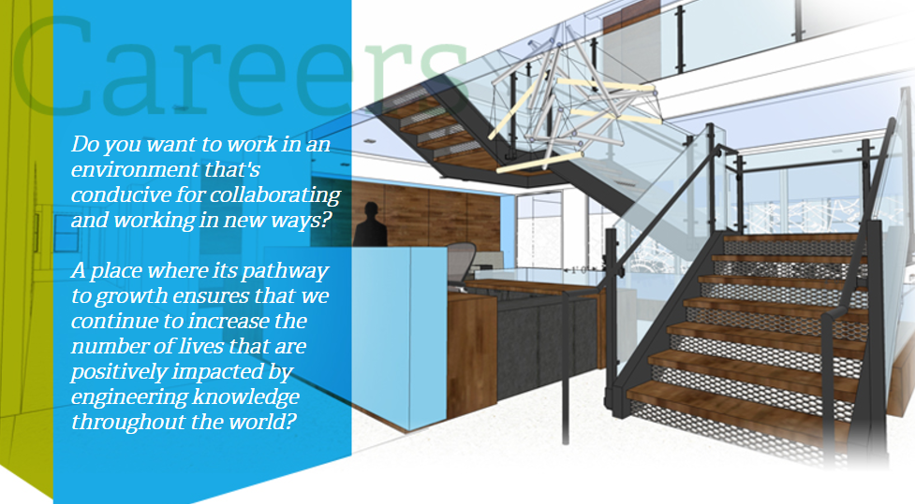
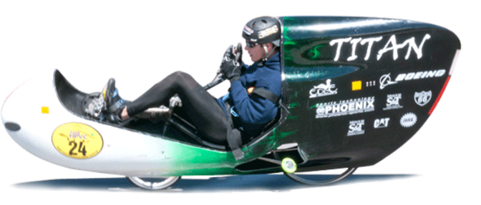
American society of mechanical
Engineers-national
COMETITION
HOST
UPCOMING
COMPETITIONS
Human Powered Vehicle Challenge (HPVC)
Application Due: 9/30/2017
Competition Date: 06/16/2018
Head Quarters Location
New York, NY
Student Design Competition
Application Due: 09/01/2017
Competition Date: 06/19/2018
Events:
Nanochannel Conference:
Date MWF
Time 4:00pm
NEXT MONTHLY MEETING:
Date 6/2/2017
Time 6:00pm
AM3D Challenge
Application Due: 10/25/2017
Competition Date: 06/16/2018
www.ASME.org
Photos
Videos
Message
Email
Call
15500 pts
Welcomed Majors:
All Majors
Who We Are
ASME is a not-for-profit membership organization that enables collaboration, knowledge sharing, career enrichment, and skills development across all engineering disciplines, toward a goal of helping the global engineering community develop solutions to benefit lives and livelihoods. Founded in 1880 by a small group of leading industrialists, ASME has grown through the decades to include more than 130,000 members in 151 countries. Thirty-two thousand of these members are students.
Message Board: The AM3D Challenge application is due next month! There are still 5 openings! If you have questions shoot us an email! All Majors can Apply!!!!
Student Design Competition
We’re excited to announce that the Student Design Competition will now be taking place at ASME’s global E-Fests (Engineering Festivals). E-Fests are three-day, two-night regional events built around design, advanced manufacturing and robotics technologies. They enable engineering students to expand their knowledge, test and showcase new skills and inspire innovation.
15505 pts
Human Powered Vehicle Challenge (HPVC):
We’re excited to announce that the HPVC events will now be taking place at ASME’s global E-Fests (Engineering Festivals). E-Fests are three-day, two-night regional events built around design, advanced manufacturing and robotics technologies. They enable engineering students to expand their knowledge, test and showcase new skills and inspire innovation.
15500 pts
1600 pts

Slide 5
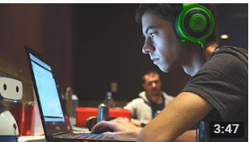

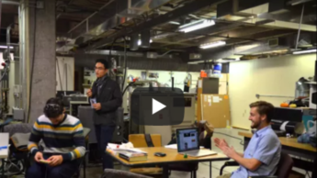
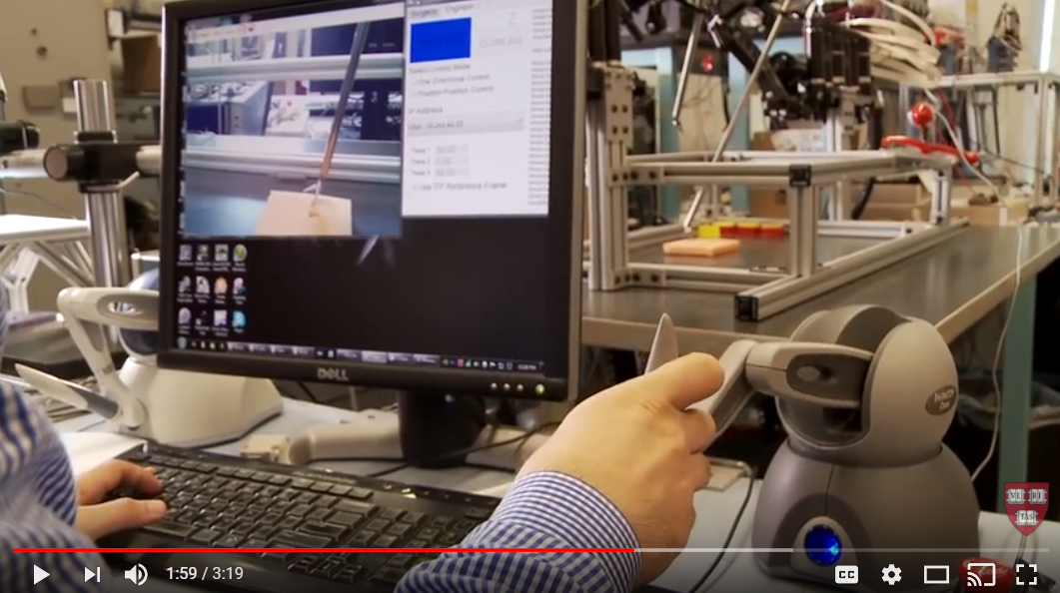

UCTech Feed
My Clubs
Create Post
FILTERS
Meeting tIMES
Massachusetts Institute of Technology
Clubs:
-All
BUILD TEAM MEETINGS:
Date MWF
Time 4:00pm
NEXT MONTHLY MEETING:
Date 6/2/2017
Time 6:00pm
Schools:
-All Schools
Companies:
-All Companies
Competition Hosts:
-All Competition Hosts
FACTS
Welcomed Majors:
All Majors
Major Percentage: Mech Engineering : 98%
Civil Engineering: 1%
Undeclared: 1%
What Happens at an MIT Hackathon
Majors:
-Mechanical Engineering
-Software Engineering
-Computer Science
-Biomedical Engineering
more….
I can’t believe we took 1st place!!
1600 pts
Majors Seeking:
Mechanical Engineers
Electrical Engineers
Comments
Write a comment…
Subjects
States:
-All States
University of Missouri-Columbia
Cities:
-All Cities
Subjects:
-Computers
-3D Printing
-3D Modeling
-Robotics
3d Printing gets recognized!
1600 pts
We created a robotic arm that can climb trees, chop wood, and do kick flips on a tech deck!
Write a comment…
Comments
Subjects
Massachusetts Institute of Technology
Robotics are coming alive!
1600 pts
We created a robotic arm that can climb trees, chop wood, and do kick flips on a tech deck!
Write a comment…
Comments
Subjects
University of Missouri-Columbia
3d Printing gets recognized!
1600 pts
We created a robotic arm that can climb trees, chop wood, and do kick flips on a tech deck!
Write a comment…
Comments
Subjects

Slide 6
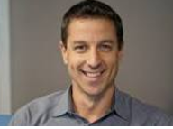
Main Page
asme
members
Meeting tIMES
BUILD TEAM MEETINGS:
Date MWF
Time 4:00pm
NEXT MONTHLY MEETING:
Date 6/2/2017
Time 6:00pm
President:
Brandon Torres
FACTS
Welcomed Majors:
All Majors
Major Percentage: Mech Engineering : 98%
Civil Engineering: 1%
Undeclared: 1%
Vice President:
Mike Jones
Competitions, YEAR:
ASME ROBOTICS 2017
ASME ROBOTICS 2016
ESRA 3D MECHANICS 2015
AWARDS:
1st Place: ASME ROBOTICS 2017
Charles T. Main Award 2017
3rd Place: ASME ROBOTICS 2016
Majors Seeking:
Mechanical Engineers
Electrical Engineers
Spring Year: 2017
We have a robotics team that travels around the world and competes against all different universities. The team is lead by Brandon Torres, a senior mechanical Engineer with the advisory help of Dr. Solbreken. Together the team has overcame real world challenges in a smaller scale through competition. If you are into robotics, challenges, and competition please follow us on CSC and come to our meetings!!!
UCTechweb Active Member:
Renee Smith
1550 pts
All Members
1600 pts

Slide 7
Search map page
asme
members
Meeting tIMES
BUILD TEAM MEETINGS:
Date MWF
Time 4:00pm
NEXT MONTHLY MEETING:
Date 6/2/2017
Time 6:00pm
President:
Brandon Torres
FACTS
Welcomed Majors:
All Majors
Major Percentage: Mech Engineering : 98%
Civil Engineering: 1%
Undeclared: 1%
Vice President:
Mike Jones
Competitions, YEAR:
ASME ROBOTICS 2017
ASME ROBOTICS 2016
ESRA 3D MECHANICS 2015
AWARDS:
1st Place: ASME ROBOTICS 2017
Charles T. Main Award 2017
3rd Place: ASME ROBOTICS 2016
Majors Seeking:
Mechanical Engineers
Electrical Engineers
Spring Year: 2017
We have a robotics team that travels around the world and competes against all different universities. The team is lead by Brandon Torres, a senior mechanical Engineer with the advisory help of Dr. Solbreken. Together the team has overcame real world challenges in a smaller scale through competition. If you are into robotics, challenges, and competition please follow us on CSC and come to our meetings!!!
UCTechweb Active Member:
Renee Smith
1550 pts
All Members
1600 pts

Slide 8
messenger
asme
members
Meeting tIMES
BUILD TEAM MEETINGS:
Date MWF
Time 4:00pm
NEXT MONTHLY MEETING:
Date 6/2/2017
Time 6:00pm
President:
Brandon Torres
FACTS
Welcomed Majors:
All Majors
Major Percentage: Mech Engineering : 98%
Civil Engineering: 1%
Undeclared: 1%
Vice President:
Mike Jones
Competitions, YEAR:
ASME ROBOTICS 2017
ASME ROBOTICS 2016
ESRA 3D MECHANICS 2015
AWARDS:
1st Place: ASME ROBOTICS 2017
Charles T. Main Award 2017
3rd Place: ASME ROBOTICS 2016
Majors Seeking:
Mechanical Engineers
Electrical Engineers
Spring Year: 2017
We have a robotics team that travels around the world and competes against all different universities. The team is lead by Brandon Torres, a senior mechanical Engineer with the advisory help of Dr. Solbreken. Together the team has overcame real world challenges in a smaller scale through competition. If you are into robotics, challenges, and competition please follow us on CSC and come to our meetings!!!
UCTechweb Active Member:
Renee Smith
1550 pts
All Members
1600 pts

